Slide 1
Google Data Analytics Capstone Project
A Case Study on Amazon ECommerce Consumer Behaviour

Slide 2
Business Task
Amazon is one of the most popular Ecommerce companies which has expanded its operations across many countries. This case study aims at conducting a behavioural analysis of Amazon’s customers to come to derive insights about their shopping patterns, interactions with the website and browsing patterns.
This data analysis will provide the stakeholders a deeper understanding of consumer behavior, identify trends, optimize marketing strategies, deliver key business insights which will help target prospective customers and improve the overall customer experience on Amazon.

Slide 3
Data Source
This dataset from Kaggle (Source) contains key variables like customer demographics , browsing and shopping patterns, user interactions with the website and customer reviews. This dataset aims to provide insights into customer preferences, shopping habits, and decision-making processes on the Amazon platform.

Slide 4
Data Cleaning
The sheet was relatively clean. A few blanks and invalid data points were there. They have been fixed. The tool used was MS Excel. Details below:
Column/Field | Anomalies | Cleanup action taken
Age | Age < 18 | Rows deleted
Product_search_method | Blanks | Rows deleted
Service_Appreciation | Invalid data value | Row deleted

Slide 5
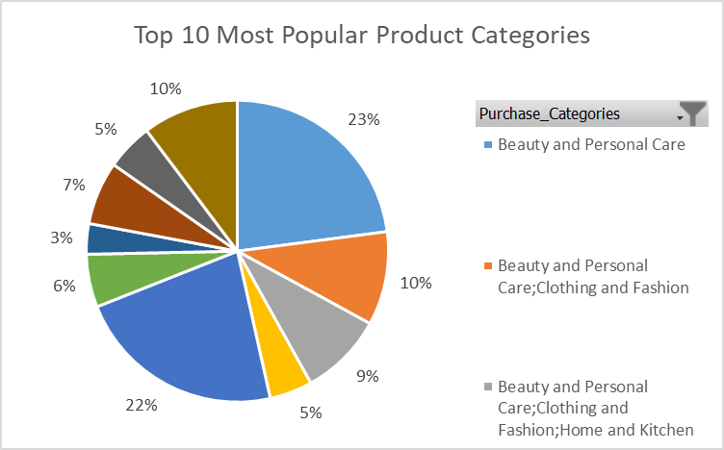
Analysis
Top 10 Most Popular Categories
Beauty and Personal care items are our most
popular items, followed by Clothing and Fashion,
Home and Kitchen categories.
Overall, the top 10 categories are in the areas
Of beauty, Fashion, Clothing, Home, Kitchen,
Groceries and gourmet

Slide 6
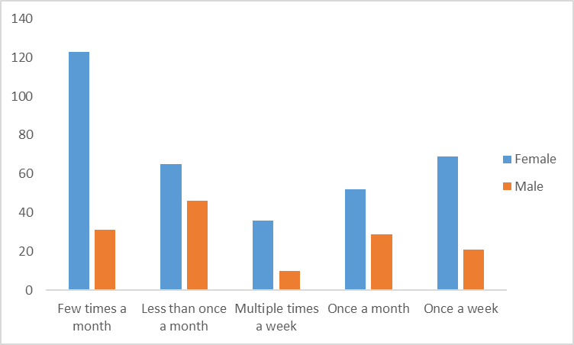
Analysis Contd.
Gender-wise Weekly Browsing Frequency
It can be deduced that our female
customers outnumber the males when
It comes to the browsing frequency.

Slide 7
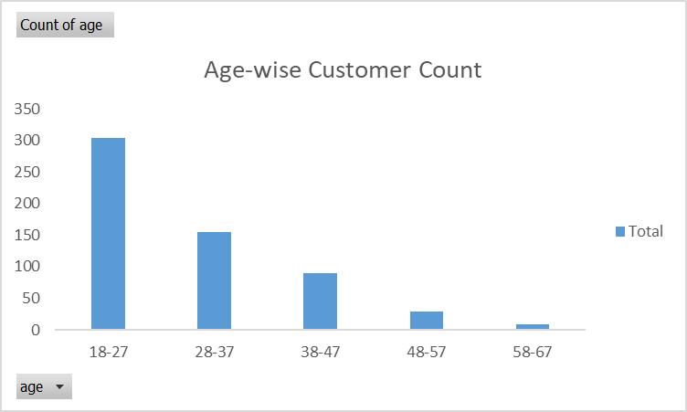
Analysis
Our highest Customers by Age:
No surprises here that the young adults form
our greatest customer base, followed by people
in the age groups of (28-47).
We can consider focusing on the 48-57 age group,
maybe making the UI more easy and simplify the
buying process, since people in this age-group have
More purchasing power and disposable income.

Slide 8
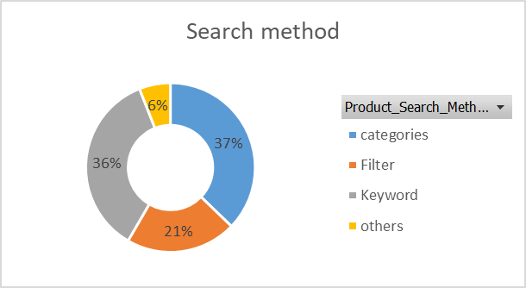
Analysis
Search Method for the customers:
Searching through Categories and
keyword are the two most popular
Methods of searching for items.
We can focus further on the Category section
of our website to make it more prominent
and visible.

Slide 9
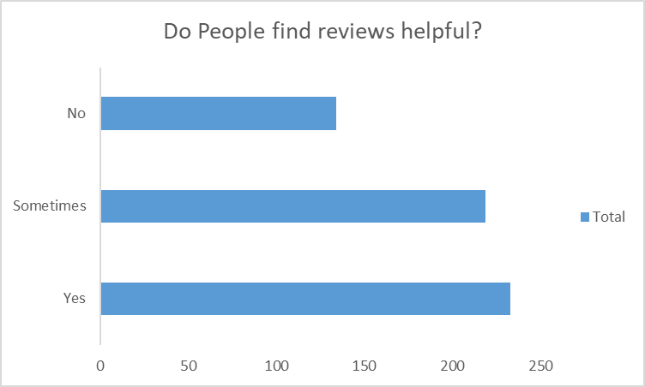
Analysis
Do people find reviews helpful?
People do find reviews helpful when
deciding on their purchase.
We need to encourage people to write
Reviews through incentives like
reward points on their Amazon Pay
balance.

Slide 10
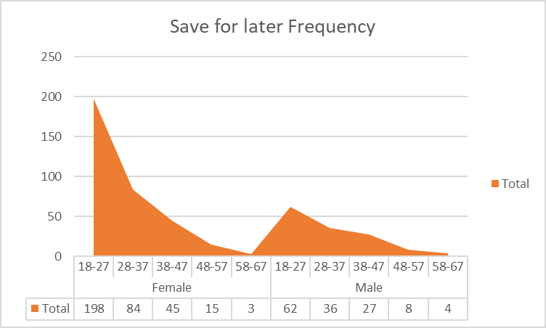
Analysis
Save for Later Tendency by Age-Gender:
No surprises, it is mostly women in the age
group of 18-27 tend to save items for later
during browsing.

Slide 11
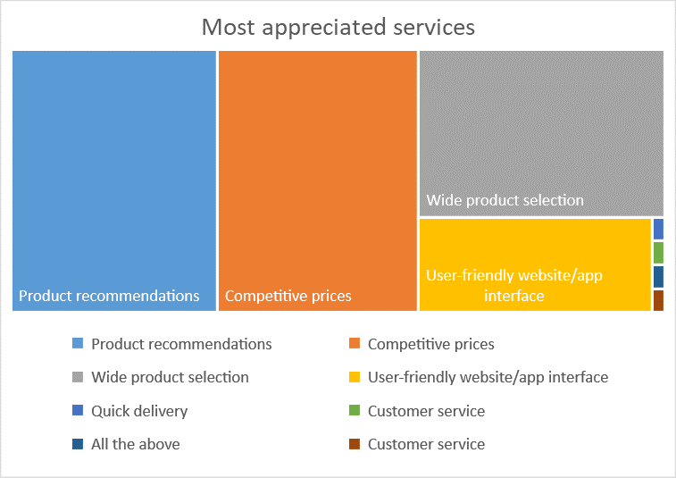
Analysis
What do Customers like the most about our
Services?
Our customers love our product recommendation,
competitive prices, range of products and our UI
the most
Customer Service lags behind in our list of
appreciated services.

Slide 12
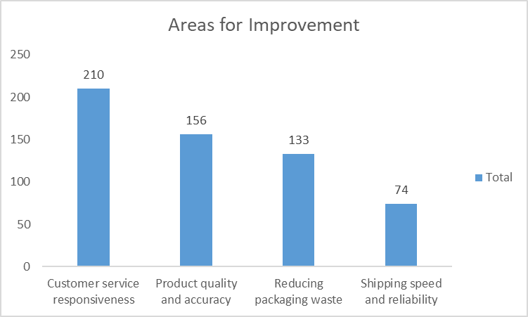
Analysis
Areas for Improvement:
It is a matter of concern that Customer Service
and Customer Response features first on the list.
We need to address customer complaints and
issues faster and effectively.
We also need to ensure quality assurance and
product accuracy.

Slide 13
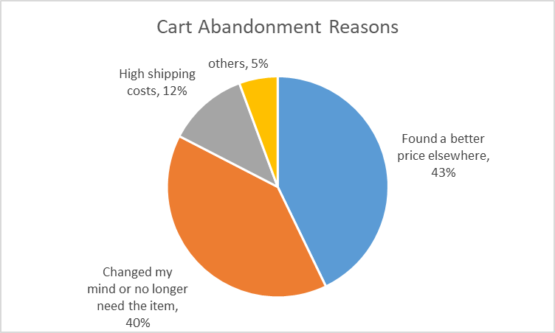
Cart Abandonment Factors
Why do people abandon their cart?
A better deal elsewhere is a major reason,
followed by change of mind behind cart
abandonment.
High shipping costs maybe a factor for
non-Prime customers.

Slide 14
Key Findings
Top 10 popular categories are in the areas of beauty, Fashion, Clothing, Home, Kitchen, Groceries and gourmet
Female customers outnumber the males when it comes to the browsing frequency.
People in the age group of 28-47 are our biggest customers.
Customers often find reviews helpful while making purchase decision.
Customers love our product recommendation, competitive prices, range of products and our UI the most.
It is a matter of concern that Customer Service and Customer Response features first on the list.

Slide 15
Recommendations
We need to address customer complaints and issues faster and effectively.
We also need to ensure quality assurance and product accuracy.
We need to conduct a survey among the 48-57 age group population to understand what impedes them from browsing our website or purchasing products from us. We can further work on targeting and improving user experience of people in the age group of (48-57) because they have high purchasing power and disposable income.
We can give rewards points on Amazon Pay Balance so that people leave behind reviews.

Slide 16
Things to consider
The scope of this study is limited is extremely limited. Additional data is required to contribute more granularity to our findings and will give more accuracy to our report.
The following data points would help more:
Data throughout the year to understand seasonality.
Customer data including customer_id, customer_name, order_value can be provided so that we can also come up with a list of customers whom we can target more with offers and other incentives.
Data collected through surveys done with population in the age group of 48-57.
Pricing data could be provided so we could further analyze which products in which price range enjoy more popularity.

